Slide 1


Specialization
Dotnet 6, ASP.Net Core
C# 9.0, WPF with Blend
Web API/Open API with Microservices
Signal R , gRPC, WCF and Web Sockets
Adv. Python, Django, Flask
AWS administration with BOTO3
DevOps, GIT, Jenkins, Docker
UML 2 and OOAD
HTML 5, CSS 3, SASS, Bootstrap
OOPS and .Net Design Patterns
ES 6/7, Jquery 3.x,,D3.js, JSON, YAML
Aurelia, Post CSS, Lost Grid, AMD
Typescript, Angular 15 & ngRx
Open UI 5.0, Vue js, Oracle Jet, PWA
React 18 & Redux , GraphQL
Ext JS 6, Backbone ,Kendo UI, Node JS,
Node js, Mongo DB & Restify
Mocha, Jasmine,Protractor, Karma
Docker, Webpack, Grunt, Gulp
Domain Driven Design (DDD)
React 18.x & Redux
Dr. D.S.R.Murthy M.Tech (IT)
Software Architect & Corporate Trainer
Experience : 31 years

Slide 2

GOOD MORNING

Slide 3
Agenda
Introduction to React js
How React works (virtual DOM)
Creating react app from scratch with webpack configuration and HMR.
React components and composition and sharing components with NPM
Props and states
Data flow and events in React js
Working with SFC and HOC
React Context API with useContext hook
Component life cycle with error handling
Styling in React with bootstrap and material UI
Working with React hooks and custom hooks and Rx js
Routing and protected routes
Lazy module loading in React and RX JS with react /Redux
Unit testing with JEST framework with code coverage
Redux and Redux API with architecture
Understanding store,reducers,actions, containers and provider
Middleware in Redux with Security in React
Redux-thunk, redux-saga,redux-logger,redux-selector,redux-promise
Redux with REST API (End to End case study) and Micro frontend Architecture
Approach of training:
Explanation of topic
Code demo on the topic
Real time examples on that topic
Doubts session on the topic
Exercise/Assignments on the topic

Slide 4
Additional topics
useMemo & useCallback

Slide 5


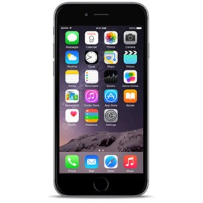


Web Challenge Now
HTML 5
CSS 3
JS / TS
Single Page App
One Structure
One Style
One Code

Slide 6

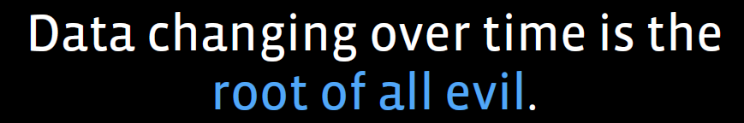
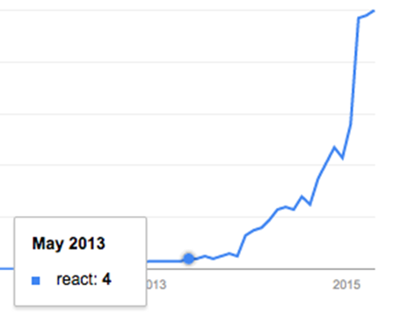
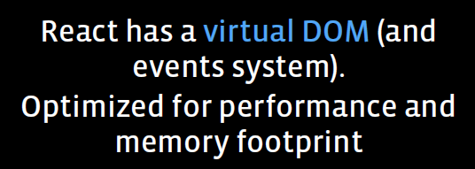
Introduction
React Goal :
Building large applications with data
that changes over time.

Slide 7
React New Features of 17.x
New Lifecycle Methods
Simpler State Management with the Context API.
ContextType — Using Context without a Consumer.
The Profiler: Using Charts and Interactions.
Lazy Loading with React.Lazy and Suspense.
Functional PureComponent with React.memo
Simplifying React apps with Hooks!
For typescript support:
$ npx create-react-app ts-app --template typescript

Slide 8
React Tool Chain
Node js > 16.x
Webpack / Gulp / Grunt for Build automation
HTML 5 with API (LocalStorage)
CSS 3 and Bootstrap , React-bootstrap for responsive design
ES 6.0 and ES2017 loader for transpilation
React and Redux /Mobx with create-react-app tool
React , redux dev tools or Mobx dev tool for debugging
Redux middleware (Logger, Thunk, Saga, …..)
Visual Studio Code IDE / ATOM …..
JEST unit testing framework
Deployment tools – Jenkins / GIT

Slide 9
Lab setup
Install node js > 16.14
Chrome browser
Visual Studio code - IDE
npm install –g create-react-app
C:/> create-react app react-app
cd react-app
npm start

Slide 10
Introduction to React JS
Born in the year 2013.
React is a UI library developed at Facebook to facilitate the creation of interactive, stateful & reusable UI components. (Component Driven Development)
It is V in MVC
It is used at Facebook and Instagram.com
Works both client and server side (Isomorphic JS)

Slide 11
Who is using React?
Facebook
Instagram
Netflix
Alibaba
Yahoo
E-Bay
Khan-Academy
AirBnB
Sony
Atlassian

Slide 12
React 16.x new features
REDUCED FILE SIZE
The React 16 size differences are smaller than the React 15 versions.
Rollup helps React to create flat bundles for different targeted formats that result in better performance in terms of size & runtime.
React is 5.3 kb decreases from 20.7 kb
React DOM is 103.7 kb down from 141 kb
React + React-DOM is 109 kb reduces from 161.7 kb

Slide 13
Virtual DOM Diff calculation (Inexpensive)
React uses virtual DOM to keep track of what has changed in the real DOM. (Fast and Minimal DOM updates)
React always keeps a copy of the representation of the actual DOM in memory.
Whenever something changes, such as some state manipulation, it calculates another copy of the DOM that will be generated with new state and props.
Then it calculates the difference between the original copy of the virtual DOM and the new copy of the virtual DOM.
This difference results in minimal operations on the real DOM that can take the current DOM to a new stage.

Slide 14
Why React ?
Simple
React will automatically manage all UI updates when underlying data changes.
Declarative
When the data changes, React conceptually hits the "refresh" button, and knows to only update the changed parts.
Build Composable Components (DRY) & Testable
React is all about building reusable components with encapsulation to make code reusable, testable (jest) and makes separation of concern.

Slide 15
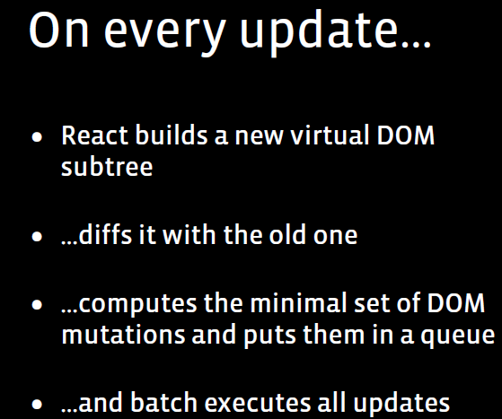
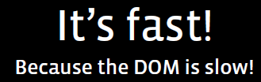
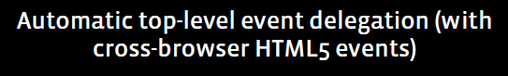
Introduction- React

Slide 16
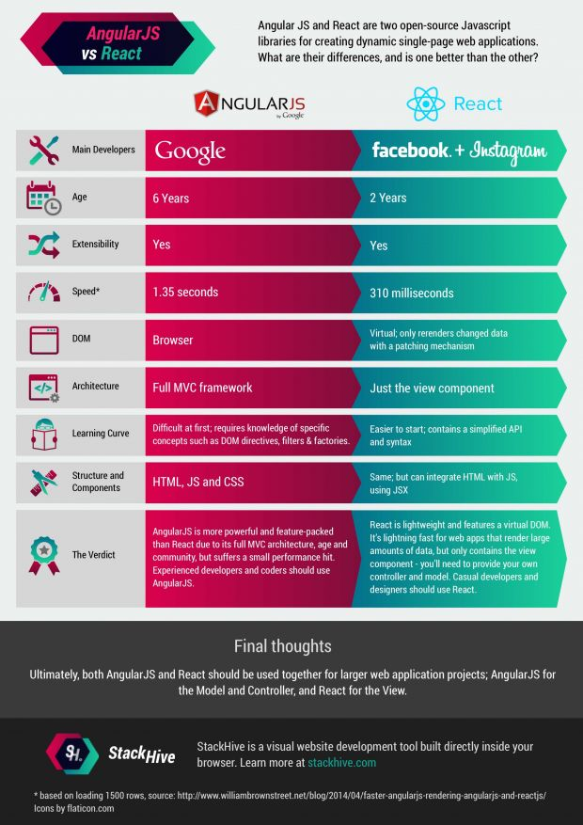
Angular vs React

Slide 17
Components
Components are the building blocks of React called widgets.
Components are like angular Directives.
You can think of a component as a collection of HTML, CSS, JS, and some internal data specific to that component.
These components are defined either in pure JavaScript or using “JSX”.
JSX is compiled to pure javascript using Babel transpiler

Slide 18
Component Tree
Virtual Tree
DOM Tree
Root (App>
Root (App>

Slide 19
React - summary
JSX — Allows us to write HTML like syntax which gets transformed to light weight JavaScript objects.
Virtual DOM — A JavaScript representation of the actual DOM.
React.Component — Describes what the UI will look like for the particular component.

Slide 20
Component tree
ROOT(APP)
Child(Header)
Child(Footer)

Slide 21
React - summary
ReactDOM.render — Renders a React component to a DOM node.
state — The internal data store (object) of a component.
constructor (this.state) - The way in which we establish the initial state of a component.

Slide 22
React - summary
setState — A helper method used for updating the state of a component and re-rendering the UI
props — The data which is passed to the child component from the parent component.
Component LifeCycle –
componentDidMount — Fired after the component mounted componentWillUnmount — Fired before the component will unmount

Slide 23
React - summary
getDerivedStateFromProps - Fired when the component mounts and whenever the props change. Used to update the state of a component when its props change
Events –
onClick
onSubmit
onChange

Slide 24
How React works?
For Change detection:
(1) React uses an observer model instead of dirty checking (continuous model checking for changes).
That’s why it doesn't have to calculate what is changed, it knows immediately.
It reduces the calculations and make the app smoother.

Slide 25
How React works?
For the DOM changing challenge
(2) React builds the tree representation of the DOM in the memory and calculates which DOM element should change.
DOM manipulation is heavy, and we would like to keep it at the minimum
React tries to keep as much DOM elements untouched as possible.
Given the less DOM manipulation can be calculated faster based on the object representation, the costs of the DOM changes are reduced nicely.

Slide 26
Components

Slide 27
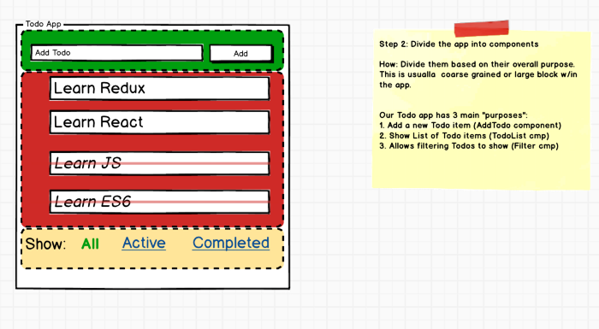
STEP 2 — Divide The App Into Components
3 components “AddTodo”, “TodoList” and “Filter” component.
Redux Terms: “Actions” And “States”
Every component does two things: 1. Render DOM based on some data. This data is called as a“state”. 2. Listen to the user and other events and send them to JS functions. These are called “Actions”.

Slide 28
React Component Tree
Store
Todoapp
AddTodo
Todolist
Filter
Todo
text
Add
TodoItem
All
Show
done

Slide 29
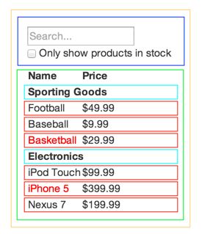
Component Driven Development – Data Flow
FilterableProductTable
SearchBar
ProductTable
ProductCategoryRow
Single Responsibility Principle
Design components to be responsible for only one thing.

Slide 30
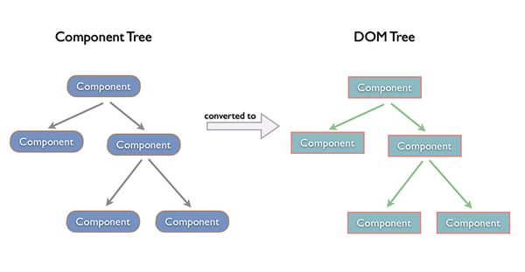
How React Works

Slide 31
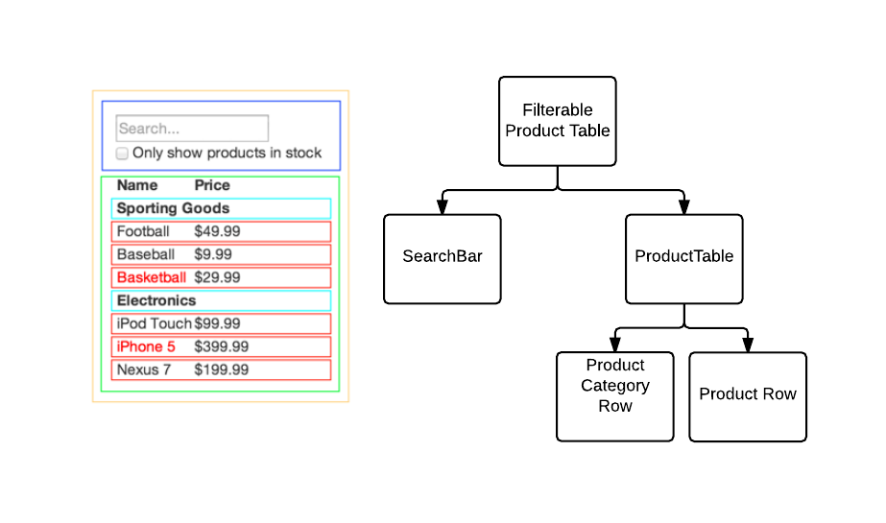
Top down rendering - FLUX

Slide 32
How React works?
For Change detection:
(1) React uses an observer model instead of dirty checking (continuous model checking for changes).
That’s why it doesn't have to calculate what is changed, it knows immediately.
It reduces the calculations and make the app smoother.

Slide 33
How React works?
For the DOM changing challenge
(2) React builds the tree representation of the DOM in the memory and calculates which DOM element should change.
DOM manipulation is heavy, and we would like to keep it at the minimum
React tries to keep as much DOM elements untouched as possible.
Given the less DOM manipulation can be calculated faster based on the object representation, the costs of the DOM changes are reduced nicely.

Slide 34
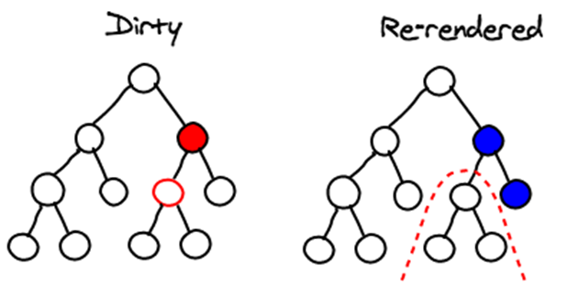
How React Works
React applies changes by running a “diffing” algorithm, which identifies what has changed.
The second step is “reconciliation”, where it updates the DOM with the results of diff.

Slide 35
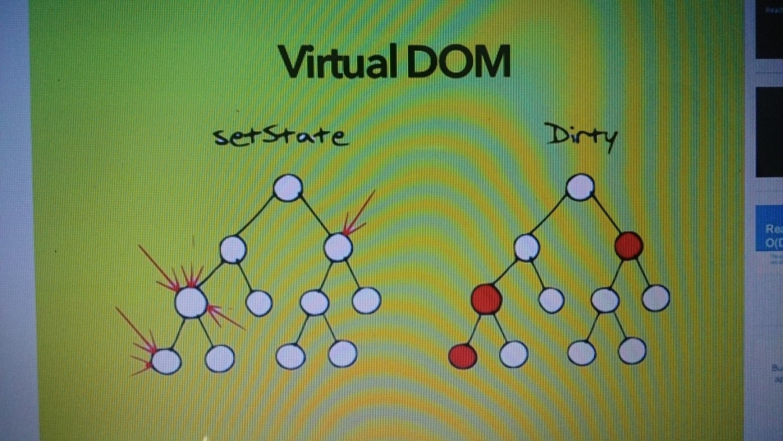
React Algorithm
The Virtual DOM
Pure render function:
f(d)=v (take data and render)
f(d’)=v’ (Data changes) - Delta
diff(v,v’)= changes (apply diff algorithm to apply DOM update where required)

Slide 36
Unidirectional Data Flow
FilterableProductTable
SearchBar
ProductTable
ProductCategoryRow
Product
Single Responsibility Principle
Design components to be responsible for only one thing.

Slide 37
Unidirectional Data Flow
Product

Slide 38
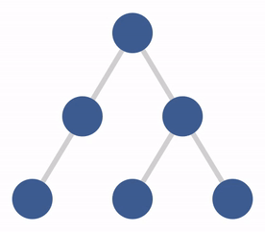
Unidirectional Data Flow

Slide 39
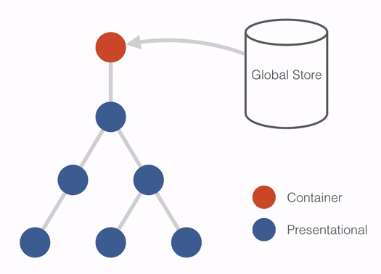
Unidirectional Data Flow

Slide 40
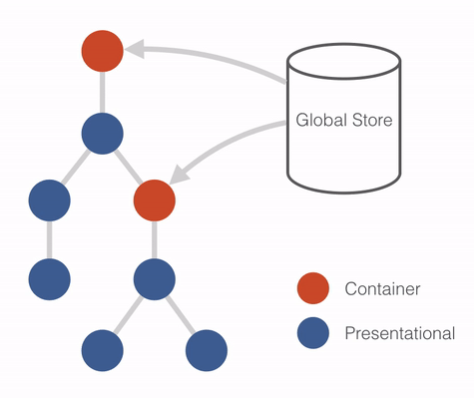
Unidirectional Data Flow

Slide 41
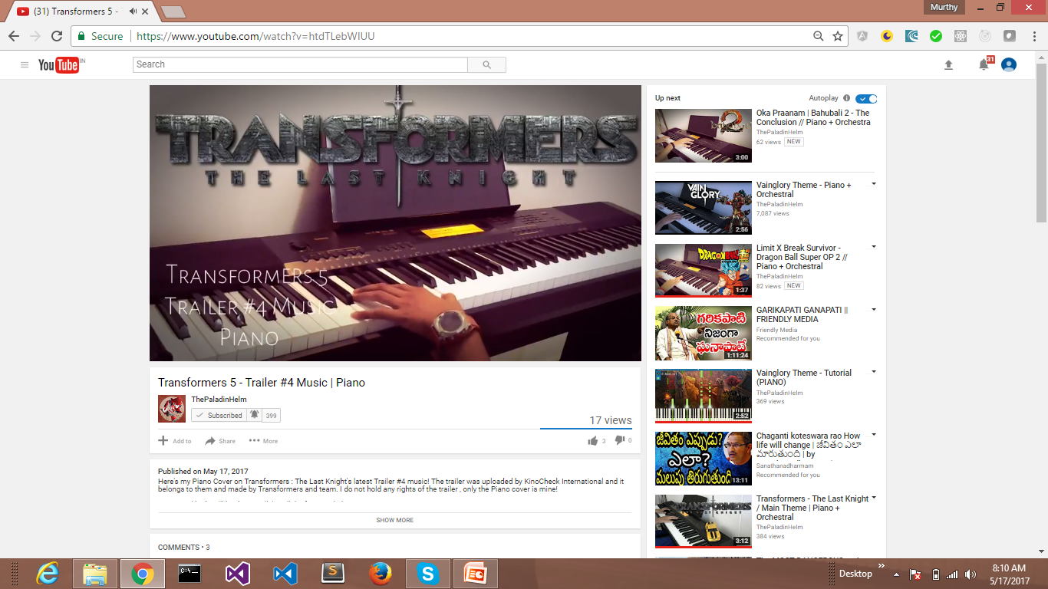
Unidirectional Data Flow
Product

Slide 42
React Redux case study

Slide 43
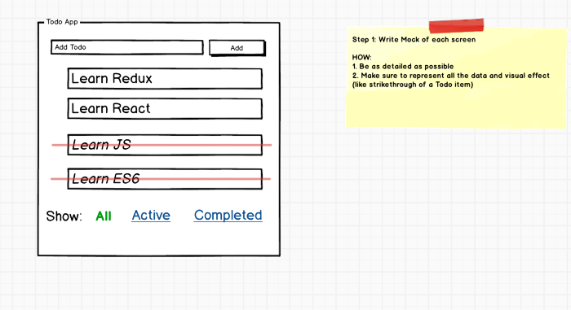
STEP 1 — Write A Detailed Mock of the Screen
Mock should include all the data and visual effects

Slide 44
STEP 2 — Divide The App Into Components
3 components “AddTodo”, “TodoList” and “Filter” component.
Redux Terms: “Actions” And “States”
Every component does two things: 1. Render DOM based on some data. This data is called as a“state”. 2. Listen to the user and other events and send them to JS functions. These are called “Actions”.

Slide 45
React Component Tree
Store
Todoapp
AddTodo
Todolist
Filter
Todo
text
Add
TodoItem
All
Show
done

Slide 46
STEP 3 — List State and Actions For Each Component
Make sure to take a careful look at each component from STEP 2, and list of States and Actions for each one of them.
We have 3 components “AddTodo”, “TodoList” and “Filter” component. Let’s list Actions and States for each one of them.
3.1 AddTodo Component — State And Actions
In this component, we have no state since the component look and feel doesn’t change based on any data but it needs to let other components know when the user creates a new Todo. Let’s call this action “ADD_TODO”.
.

Slide 47
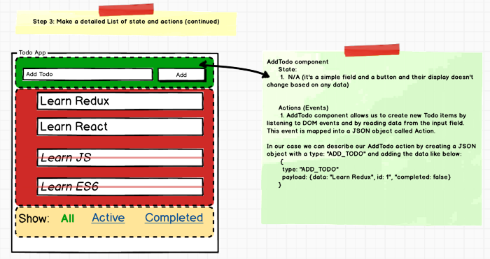

Slide 48
3.2 TodoList Component — State And Actions
TodoList component needs an array of Todo items to render itself, so it need a state, let’s call it Todos (Array).
It also needs to know which “Filter” is turned on to appropriately display (or hide) Todo items, it needs another state, let’s call it “VisibilityFilter” (boolean).
it allows us to toggle Todo item’s status to completed and not completed.
We need to let other components know about this toggle as well. Let’s call this action “TOGGLE_TODO”
.

Slide 49
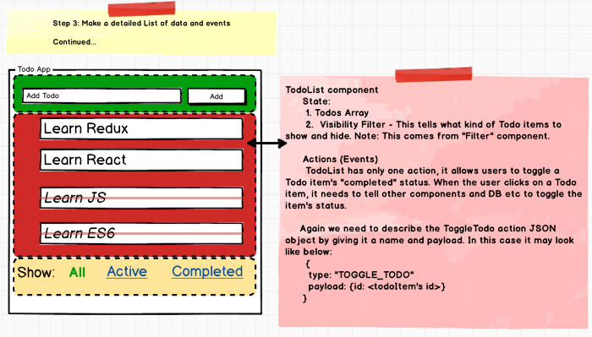
3.2 TodoList Component — State And Actions

Slide 50
3.3 Filter Component — State And Actions
Filter component renders itself as a Link or as a simple text depending on if it’s active or not.
Let’s call this state as “CurrentFilter”.
Filter component also needs to let other components know when a user clicks on it. Let’s call this actions, “SET_VIBILITY_FILTER”
.

Slide 51
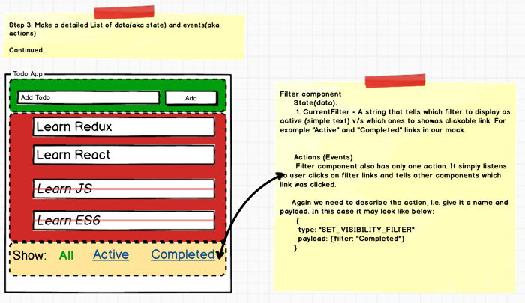
3.3 Filter Component — State And Actions

Slide 52
STEP 4 — Create Action Creators For Each Action
We have total 3 actions: ADD_TODO, TOGGLE_TODO and SET_VISIBILITY_FILTER.
Redux Term: “Reducers”
Reducers are functions that take “state” from Redux and “action” JSON object and returns a new “state” to be stored back in Redux. 1. Reducer functions are called by the “Container” containers when there is a user action. 2. If the reducer changes the state, Redux passes the new state to each component and React re-renders each component

Slide 53
STEP 5 — Write Reducers For Each Action
Redux Term: “Presentational” and “Container” Components
Keeping React and Redux logic inside each component can make it messy, so Redux recommends creating a dummy presentation only component called “Presentational” component and a parent wrapper component called “Container” component that deals w/ Redux, dispatch “Actions” and more. The parent Container then passes the data to the presentational component, handle events, deal with React on behalf of Presentational component.

Slide 54
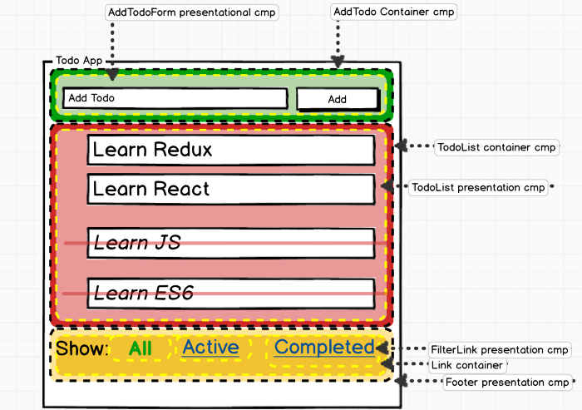

Slide 55
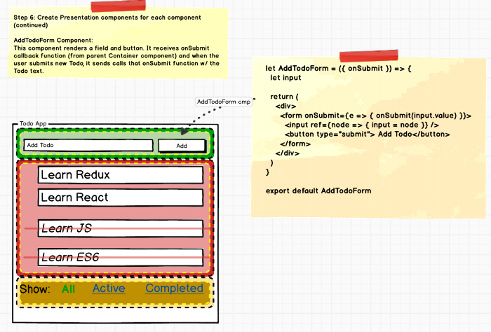
6.1 — Implement AddTodoForm Presentational Component

Slide 56
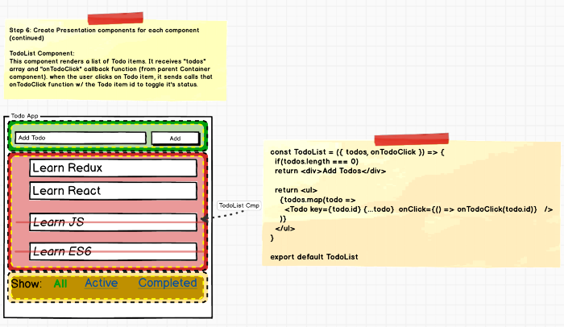
6.2 — Implement TodoList Presentational Component

Slide 57
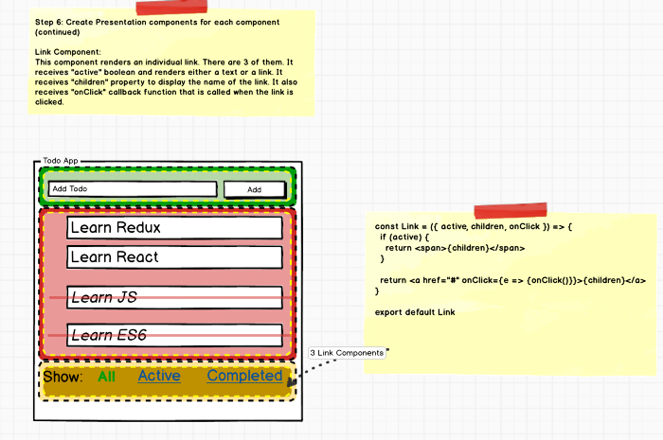
6.3 — Implement Link Presentational Component

Slide 58
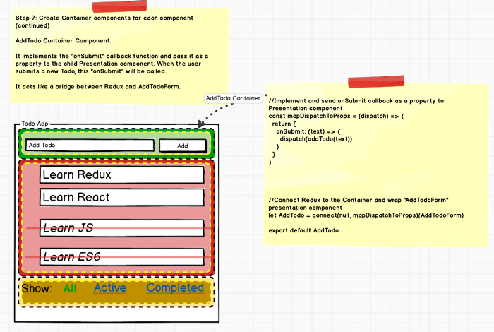
STEP 7 — Create Container Component
7.1 Create Container Component — AddTodo

Slide 59
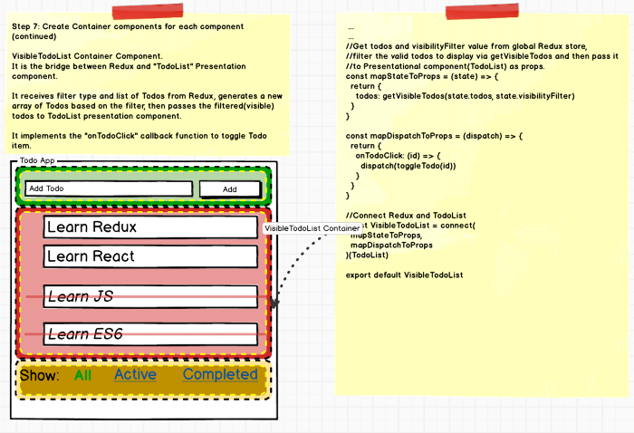
7.2 Create Container Component — TodoList Container

Slide 60
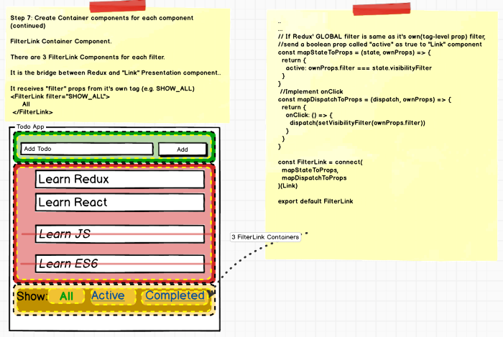
7.3 Create Container Component — Filter Container

Slide 61
STEP 8 — Finally Bring Them All Together

Slide 62
Editors for React JS
Sublime Text 3.0 with Babel plugin
Eclipse
Visual Studio 2013
Jet Brains
JS Fiddle
https://jsfiddle.net/guillaumemaka/jwm6k66c/
(Google search: react fiddle to get above link)

Slide 63
Build tools / Bundlers with HMRE
Install node js from nodejs.org
C:\> node -version
C:\>npx install create-react-app -g
C:\>create-react-app reactproject

Slide 64
React with Typescript
$ npx create-react-app ts-app --template typescript
$ cd ts-app
$ npm start

Slide 65
React build and deployment
$ npm run build
Observe build folder with resources
$ npm install -g serve
$ serve -s build
Find out more about deployment here:
bit.ly/CRA-deploy

Slide 66
JSX – JavaScript and XML
JSX is a XML-like syntax extension to ECMAScript.
React provides a convenient XML-based extension to JavaScript, called JSX, to build the component tree as a set of XML nodes.
JSX simplifies the association of event-handlers and properties as xml attributes.
A JSX XML node maps directly to a Component.
Because JSX is not supported in browsers by default we have to compile it to JS.
(Babel can transpile JSX to JS).

